Slide 1



enlight
An optimized raycasting approach for subtractive manufacturing simulation and visualization
Notes:
Welcome
Project from work at RISC, 18 months
Research project, funded by regio 13 program and land oö
Not a product presentation
Rather technical
Deals with difficulties in visualizing subtractive manufacturing
For production of industrial components, mainly metalic
Developed a solution based on ray casting
Goal: real time visualization

Slide 2
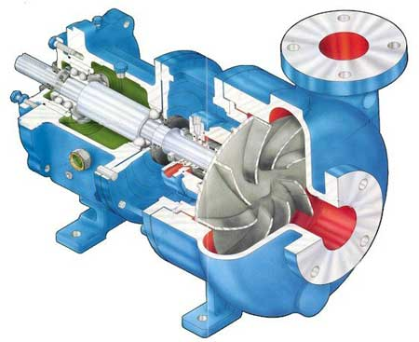
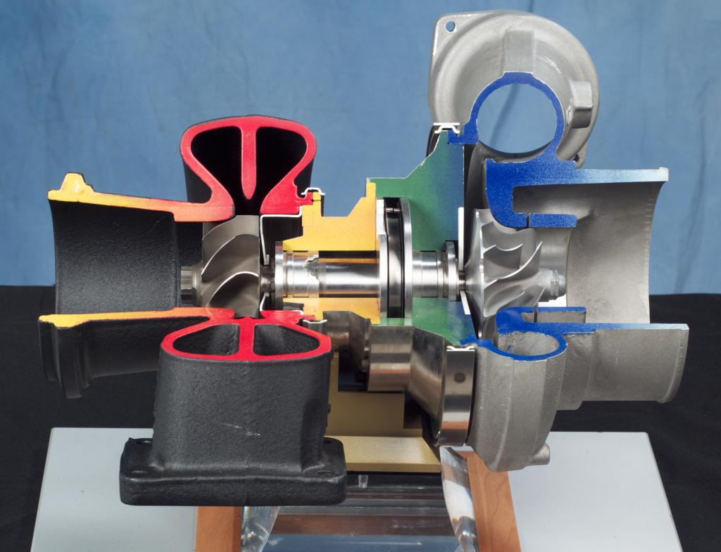
Industrial components – e.g. impellers
http://www.globalpumps.in/matherplatt.html
http://en.wikipedia.org/wiki/File:Turbocharger.jpg
Notes:
Water pump
Turbo charger

Slide 3
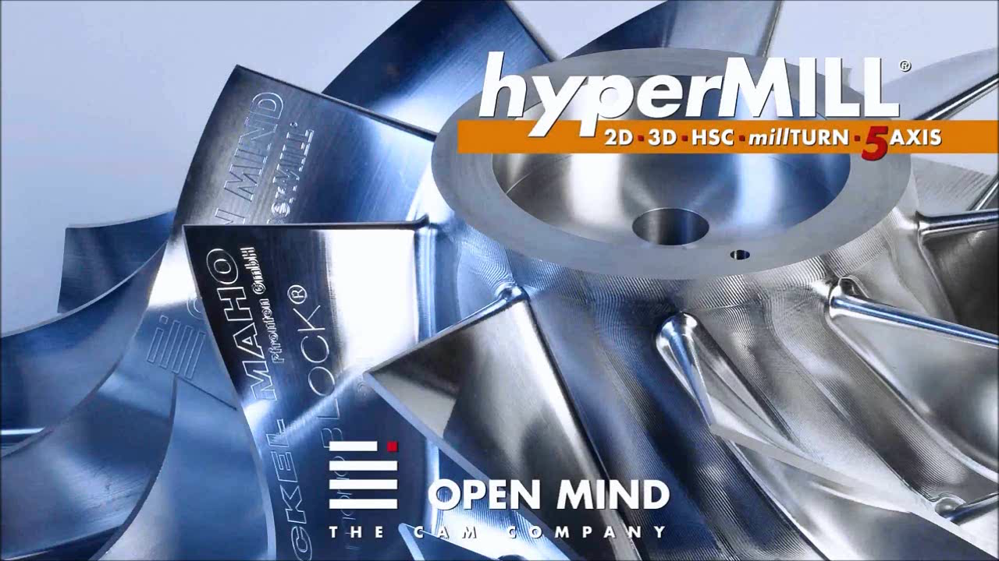
Milling - Subtractive manufacturing
Adapted from: https://www.youtube.com/watch?v=P0ImcDi_B0o
Notes:
Short video showing how an impeller is manufactured
Mind the details
Grooves between the blades

Slide 4
Overview
Problem specification
Basic visualization approach
Optimization I, II, III
Results

Slide 5
Problem specification

Slide 6
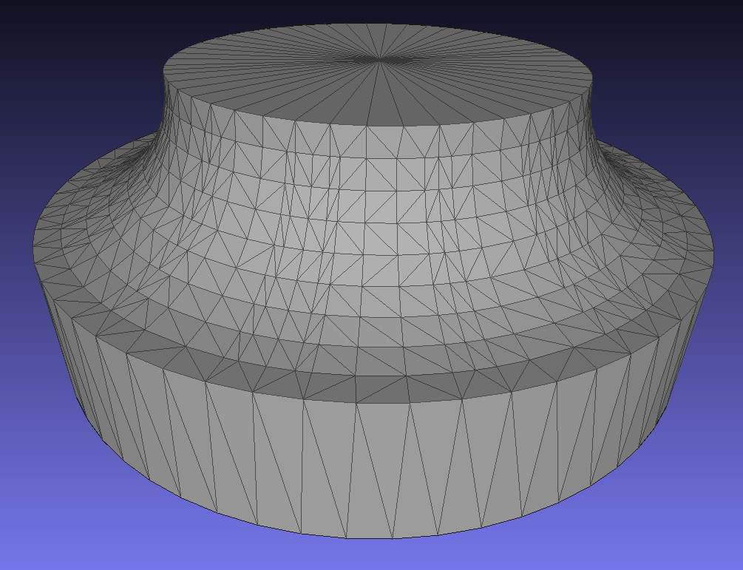
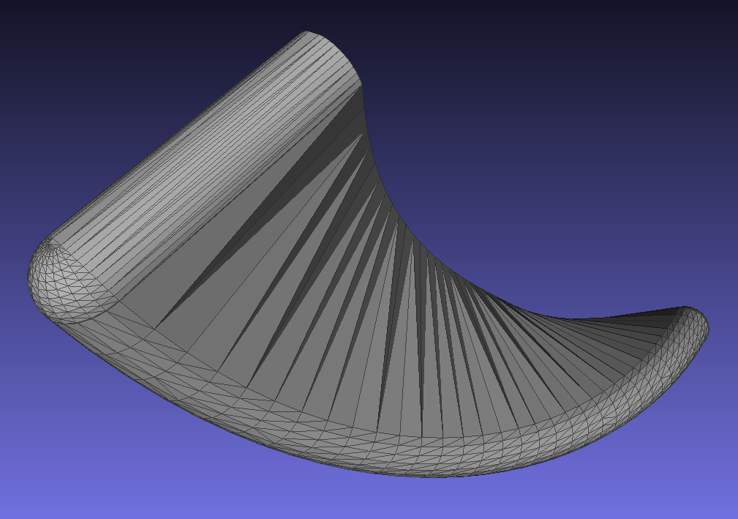
Input for digital simulation
MeshLab screen shots of low resolution input meshes
Notes:
Triangle meshes
Stock volume, initial piece
SV, calculated from cutter geometrie and transformations
On the fly SV calculation is in progress

Slide 7
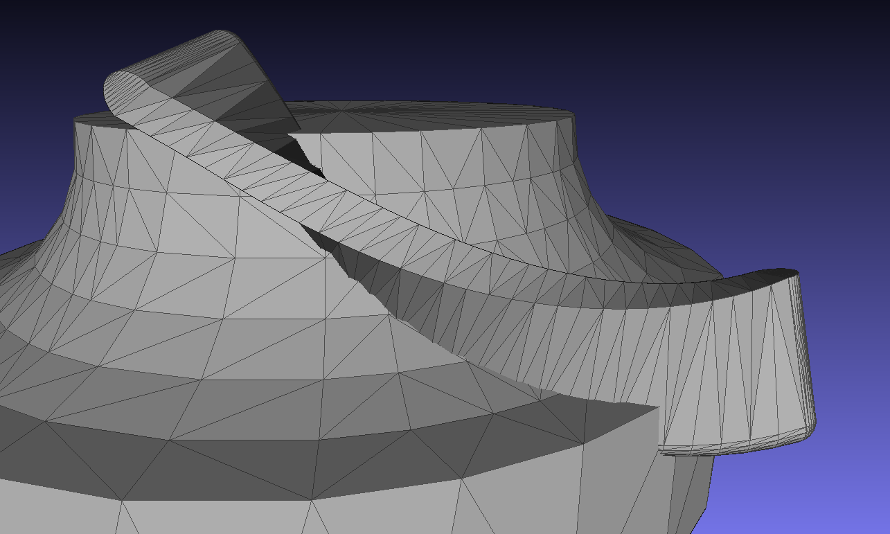
Problem situation
MeshLab screen shots of low resolution input meshes
Notes:
SV cuts triangles
Rendered in MeshLab using OpenGL
Triangle parts of SV outside stock should not be visible
Triangle parts of stock inside SV should not be visible
Cannot be solved by rendering API itself
Traditional approaches need surface triangles

Slide 8
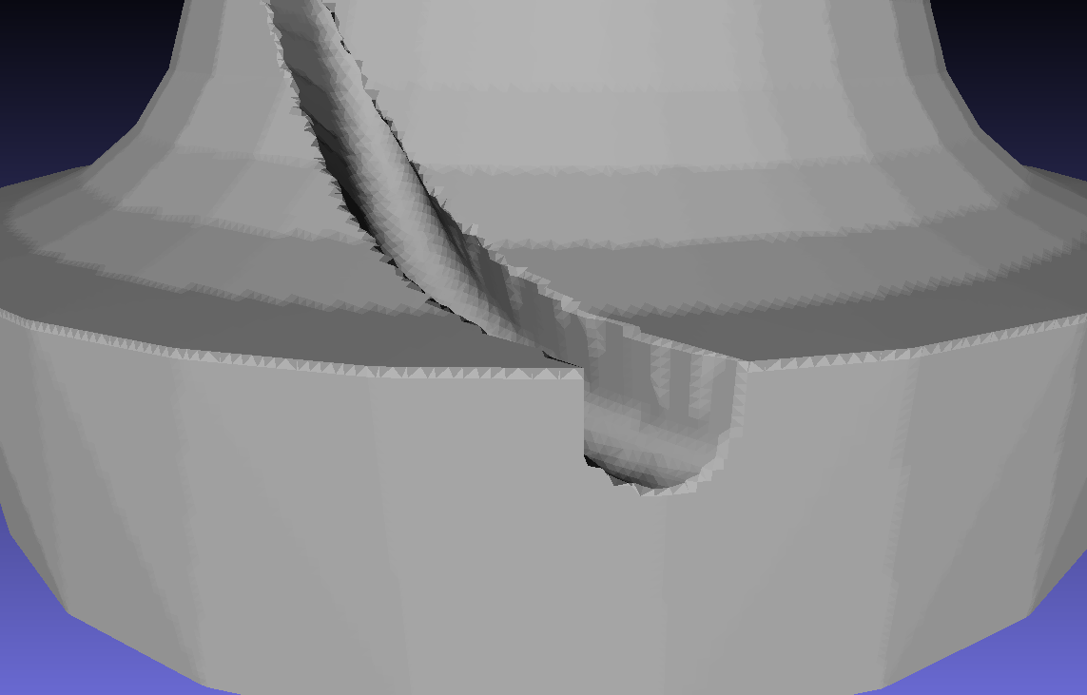
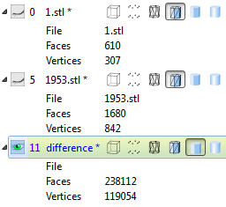
Existing methods – e.g. marching cubes
Explicit surface calculation using MeshLab
Notes:
There exist methods for calculating the exact surface EXPLICIT
Slow
Many approaches are just approximations
Image shows approximation using voxel model and marching cubes
Mind triangle count

Slide 9
Basic visualization approach
Notes:
Has to be implicit
No triangle cutting should be necessary
Let's look at other rendering techniques

Slide 10
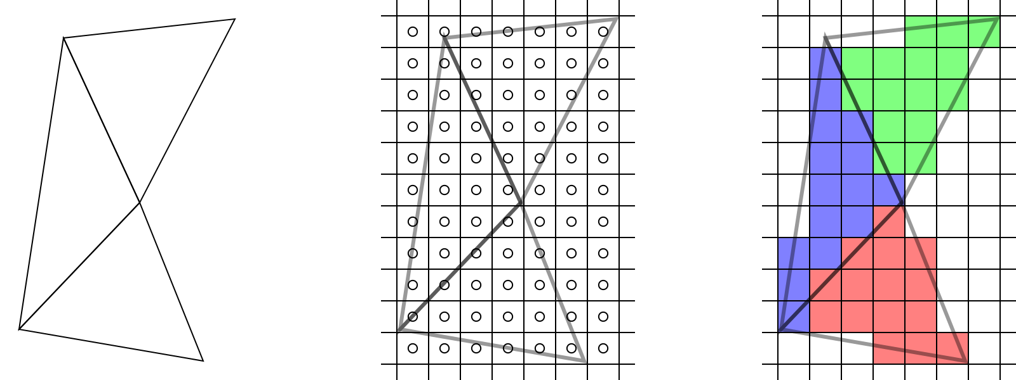
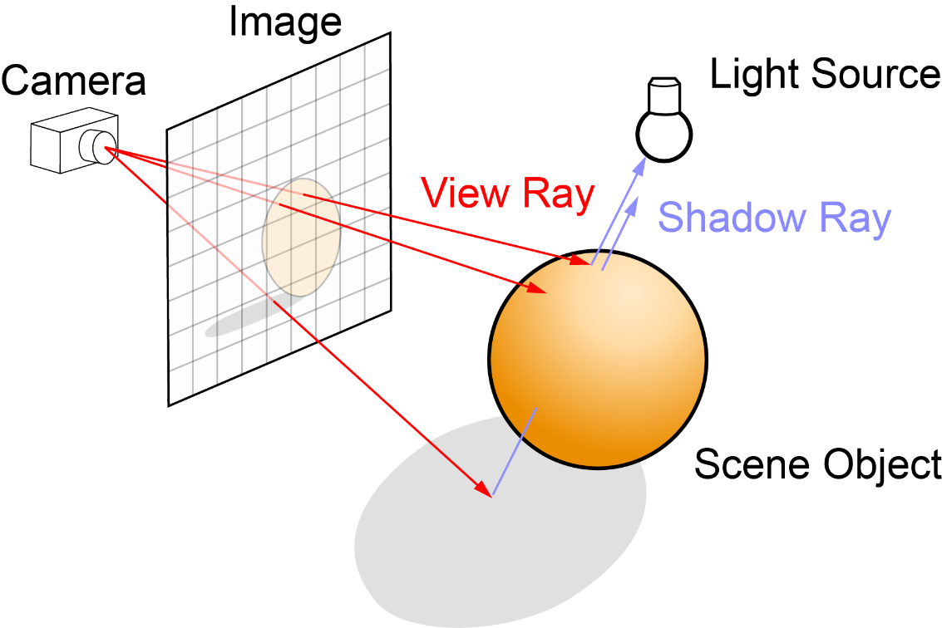
Rendering 3D geometry
Rasterization (OpenGL, DirectX)
Ray tracing/casting
http://www.arcsynthesis.org/gltut/basics/Intro%20Graphics%20and%20Rendering.html
http://en.wikipedia.org/wiki/Ray_tracing_(graphics)#mediaviewer/File:Ray_trace_diagram.svg
Notes:
Raster:
based on triangles (primitives),
primitives are transformed and mapped on a pixel grid,
affected pixels are colored
Pixel may be written multiple times
Ray:
more natural,
ray immitates flow of light,
Allows more powerful calculations
Requires full scene to be acccessible

Slide 11
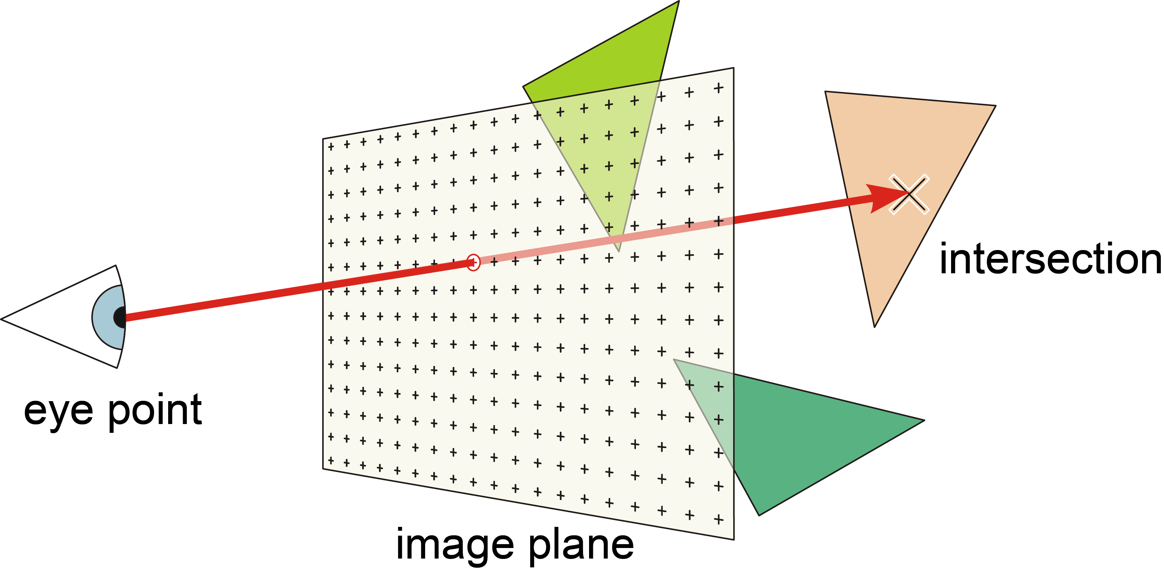
Ray casting
http://de.academic.ru/dic.nsf/dewiki/1163221
Notes:
rays don't need to stop at first intersection
Can cast further rays (for shading)
Can pass through if transparent
Can pass through if not surface

Slide 12
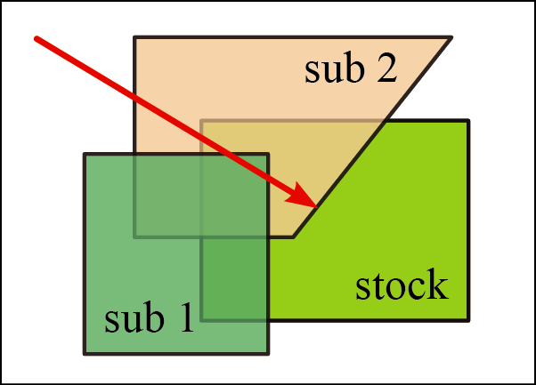
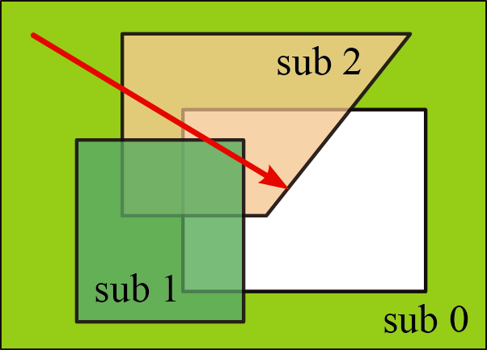

Swept volumes - entry/exit counting
Notes:
Invert stock
Initiate ray with -1 (inside stock SV)
Decrement on every entry
Increment on every exit
Surface hit when reaching 0

Slide 13
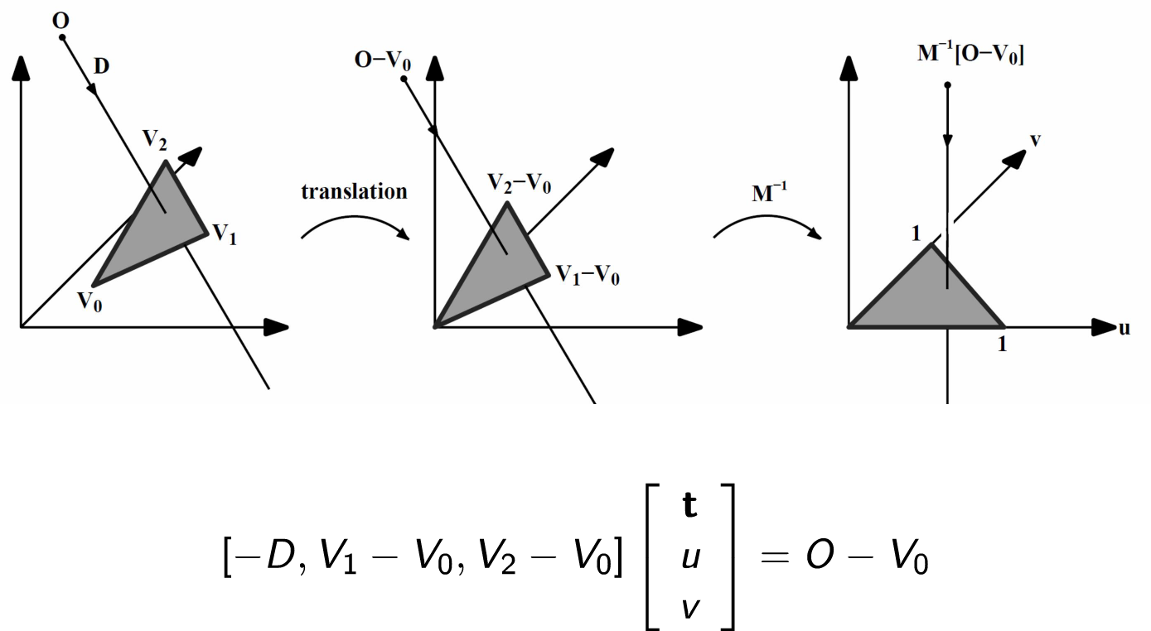
Triangle ray intersection
Fast, Minimum Storage Ray/Triangle Intersection, Möller & Trumbore, 1997
Image: Torsten Welsch
Notes:
Core of algorithm
15 lines of code
Transform triangle to a new coordinate system
Vertex 0 is origin
Edges ajacent to vertex 0 are axes
Remember 2 semester
First part is Basis/generating system creates vector space (last image)
Express ray origin in triangle coordinate system

Slide 14
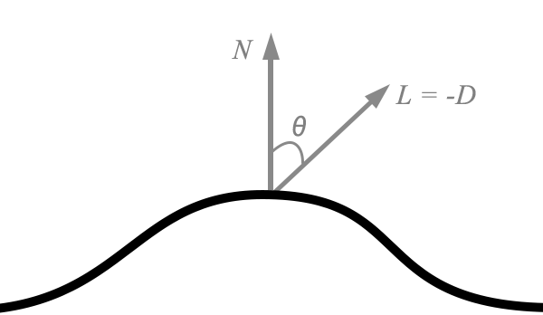
Ray casting result and coloring
Per ray/pixel
Distance/position
Normal vector of hit triangle
http://metalbyexample.com/up-and-running-3/

Slide 15
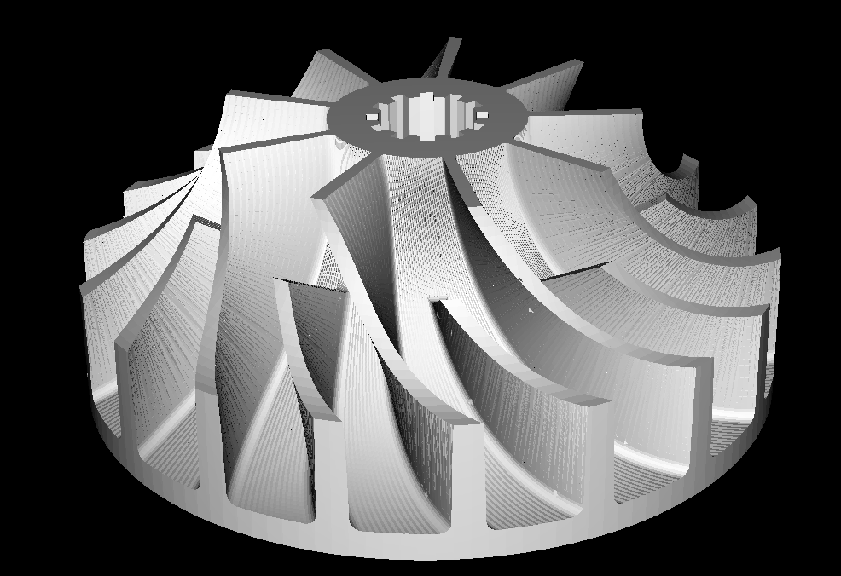
OpenGL integration - Composition
Write calculated color values directly to frame buffer (glDrawPixels)
Fast
Color calculation entirely on CPU

Slide 16
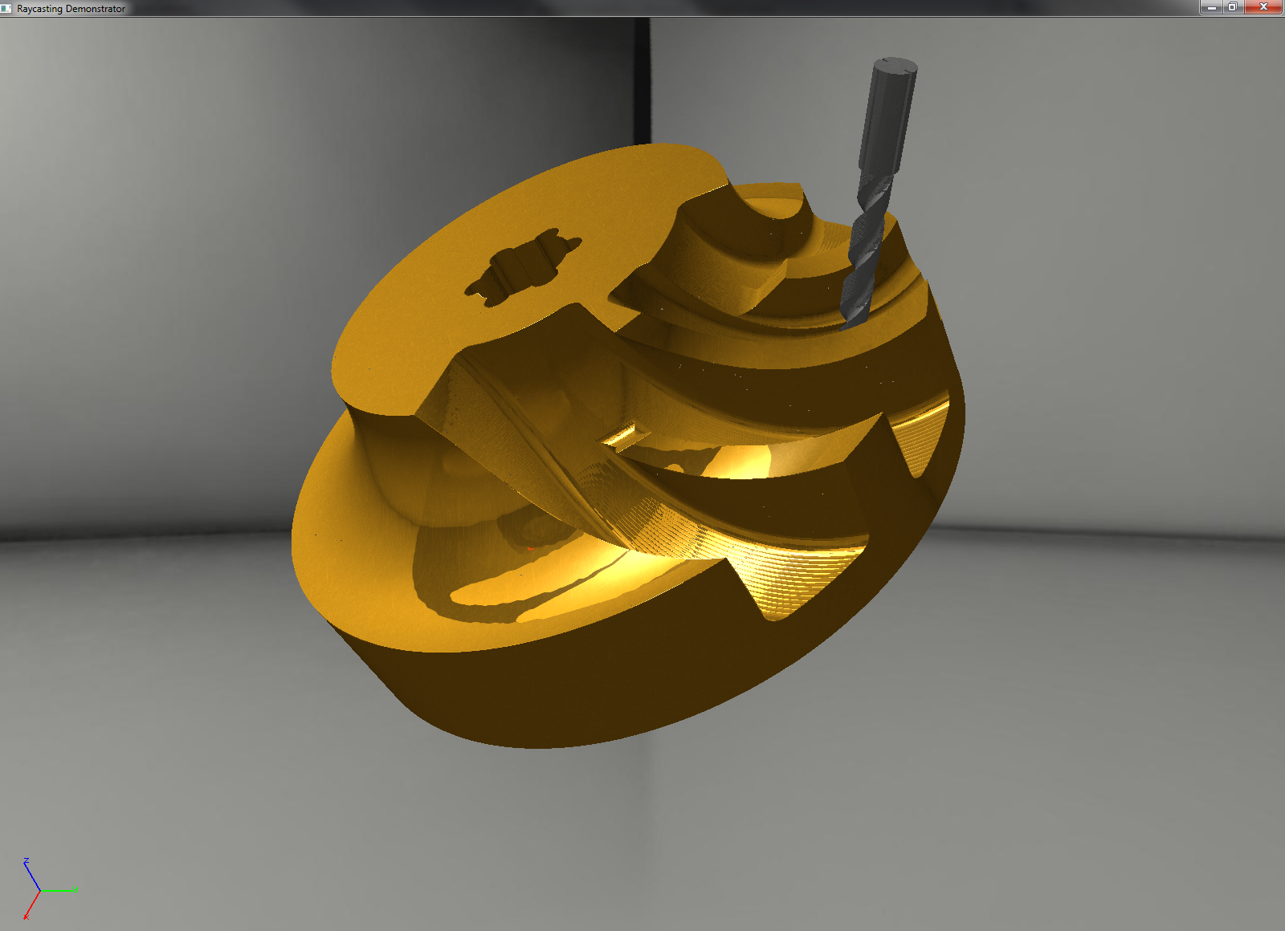
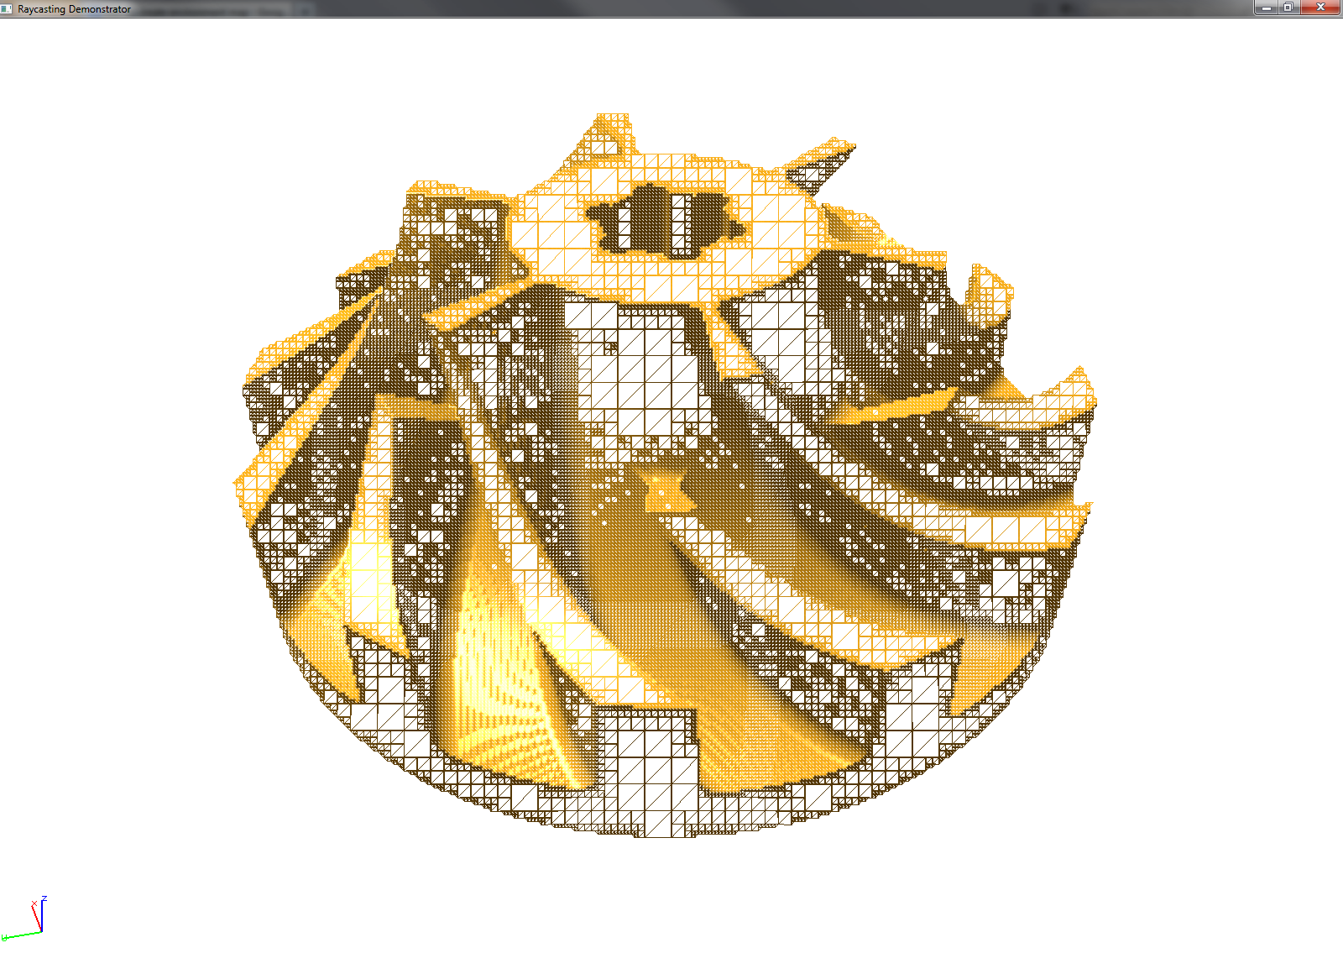
OpenGL integration - Retriangulation
Triangulation on CPU
Full graphics pipeline on GPU

Slide 17
Optimization I
Reducing intersection tests

Slide 18
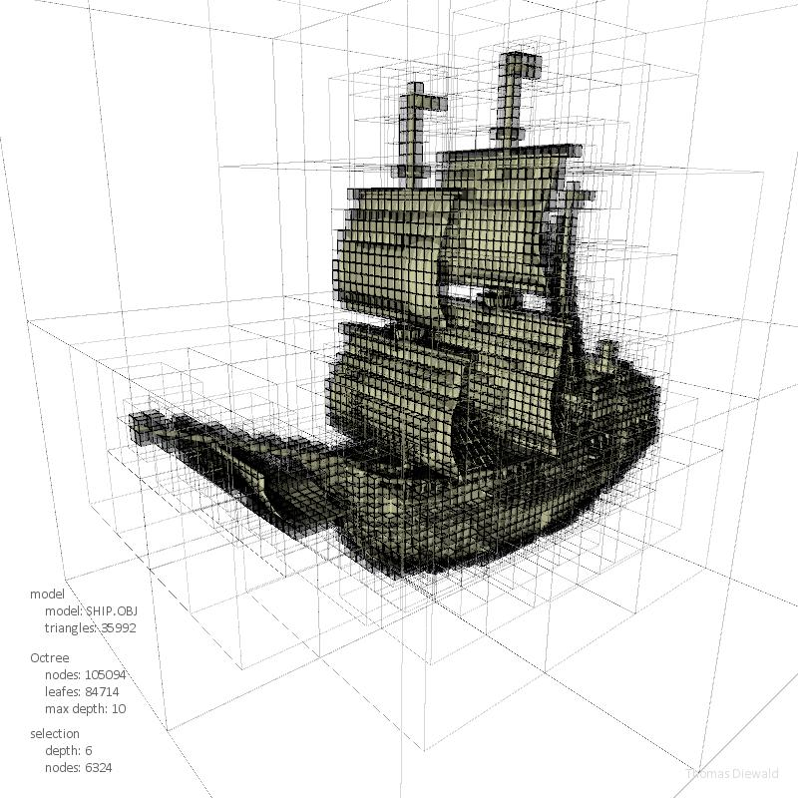
Acceleration structures
Trees
K-d trees
Octrees
Bounding volume hierarchy
Regular grids
http://thomasdiewald.com/blog/?p=1488

Slide 19
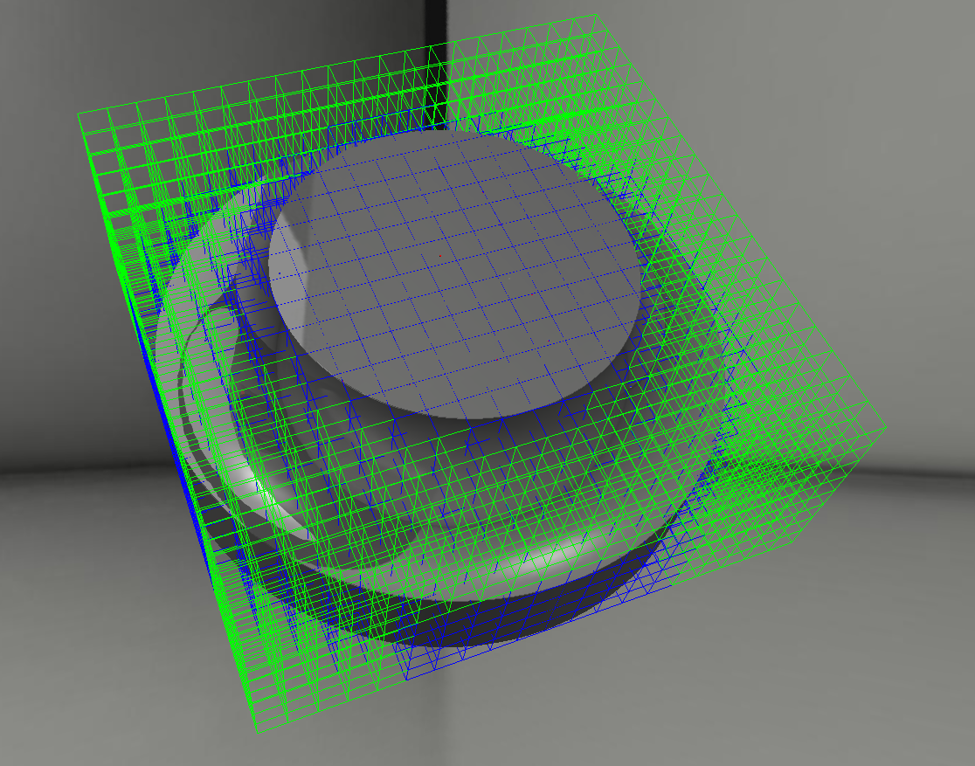
Regular grid
Simple
Fast modifications

Slide 20
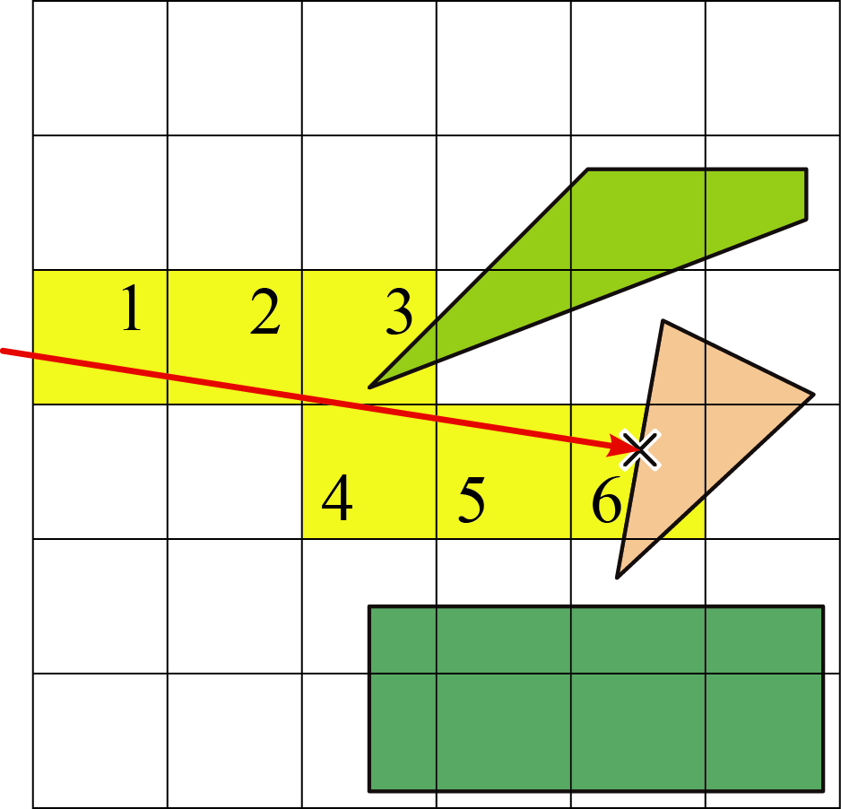
Traversal – 3D DDA
A fast voxel traversal algorithm for ray tracing, John Amanatides and Andrew Woo, 1987
Notes:
Digital differential analyzer

Slide 21
Optimization II
Reducing triangle count

Slide 22
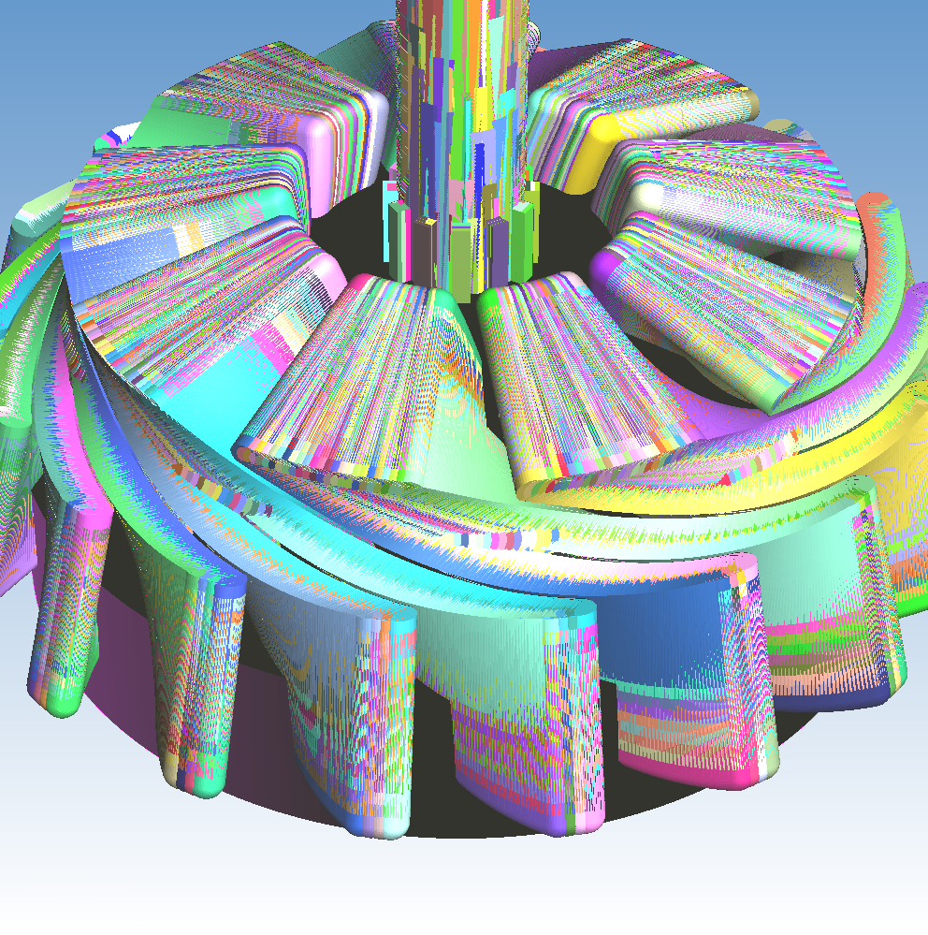
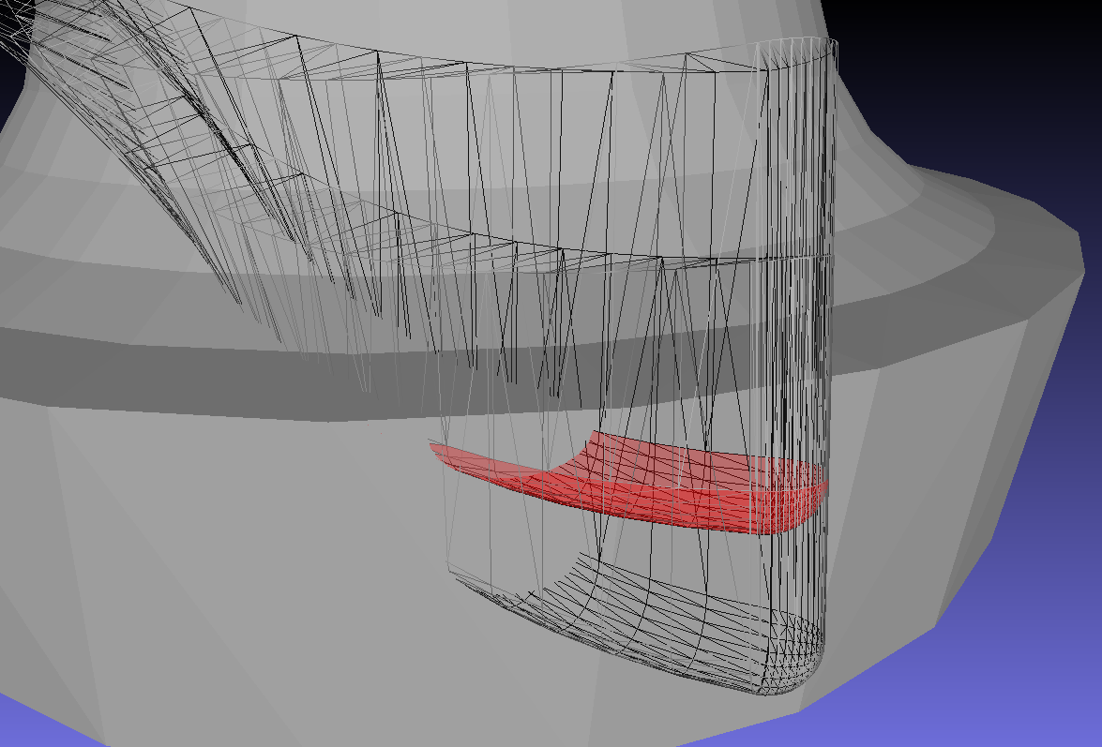
Optimizing triangle count
Screen shot of selected triangles in MeshLab

Slide 23
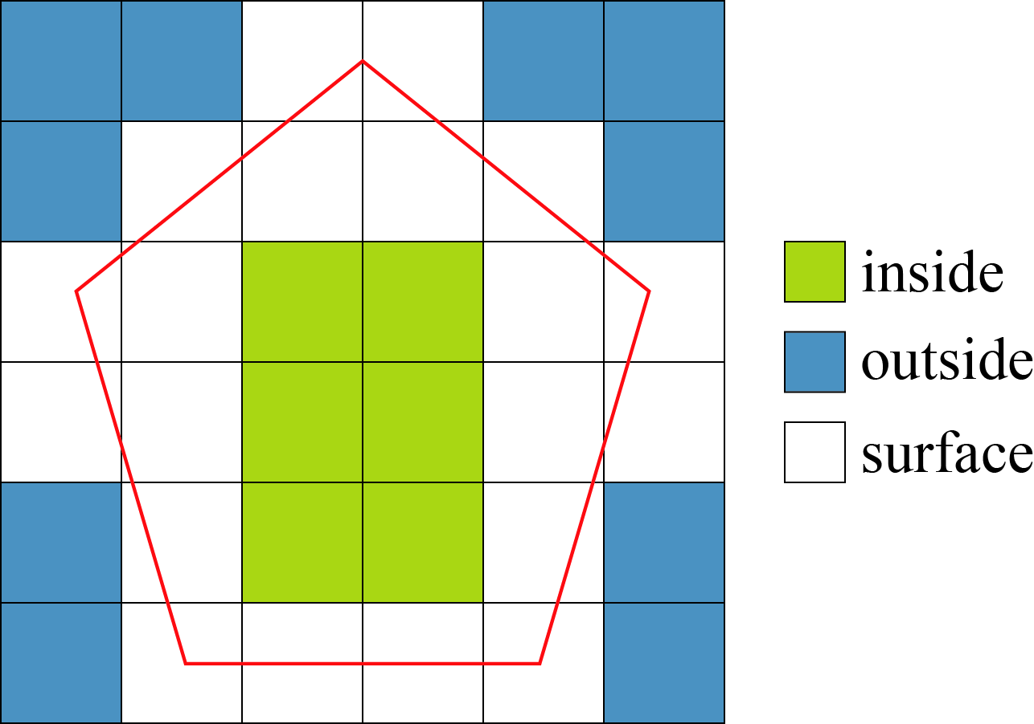
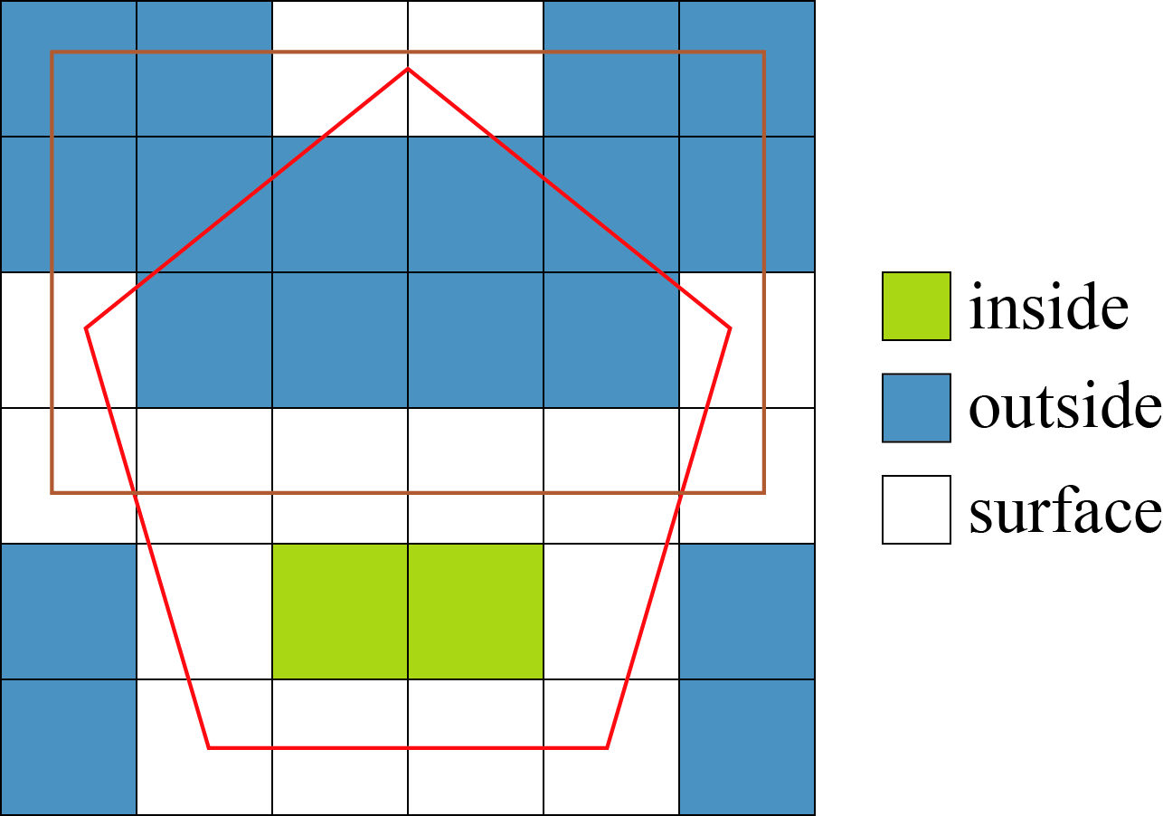
Cell classification

Slide 24
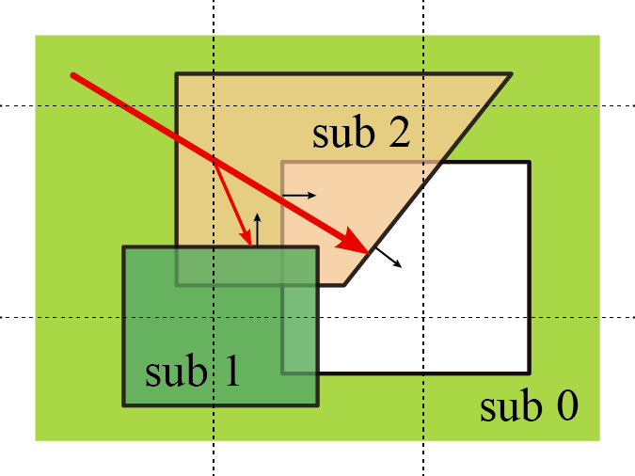
Open volumes
Notes:
Previously counter along ray
Now counter recalculated in each cell
Ray has to know in how many SVs it is upon entry

Slide 25
Triangle reduction
Notes:
Reduced triangles to 20%

Slide 26
Optimization III
Hardware architecture

Slide 27
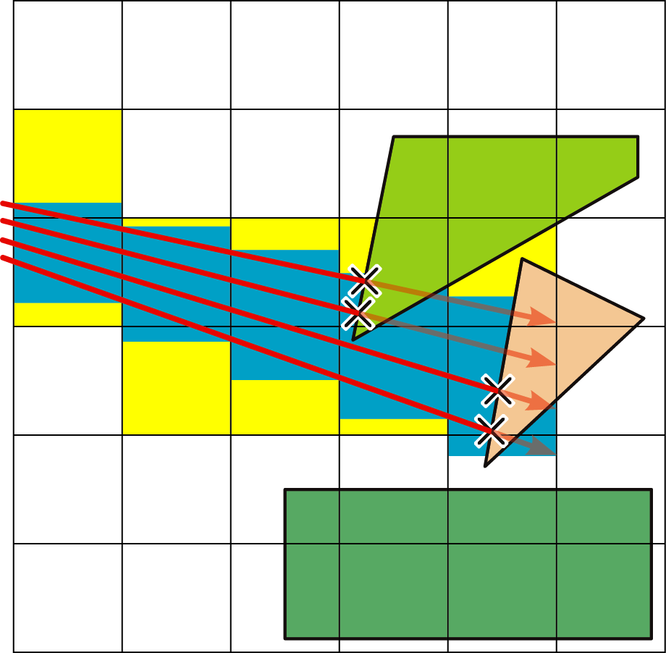
Vectorization and memory locality - Packets
Ray tracing animated scenes using coherent grid traversal, Ingo Wald et al., 2006
Notes:
Ajacent rays hit same cells and triangles
Retrieve same data from memory (temporal locality) or closely placed data (spatial locality)
Execute same instructions (-> vectorization)
Traversal information can be calculated for a whole packet

Slide 28
Results

Slide 29

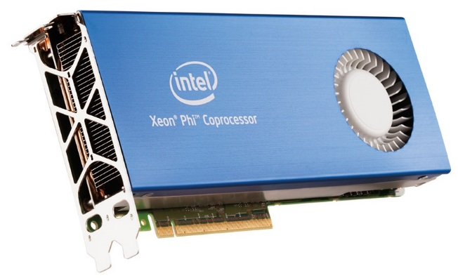
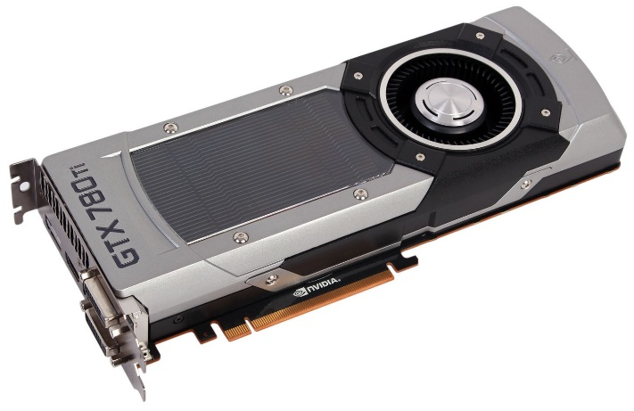
Runtime benchmark
http://www.pcper.com/reviews/Mobile/Intel-Core-i7-3720QM-Ivy-Bridge-Mobile-Review-Monster-Kill
http://www.anandtech.com/show/6265/intels-xeon-phi-in-10-petaflops-supercomputer
http://www.bit-tech.net/hardware/graphics/2013/11/07/nvidia-gtx-780-ti-3gb-review/1

Slide 30
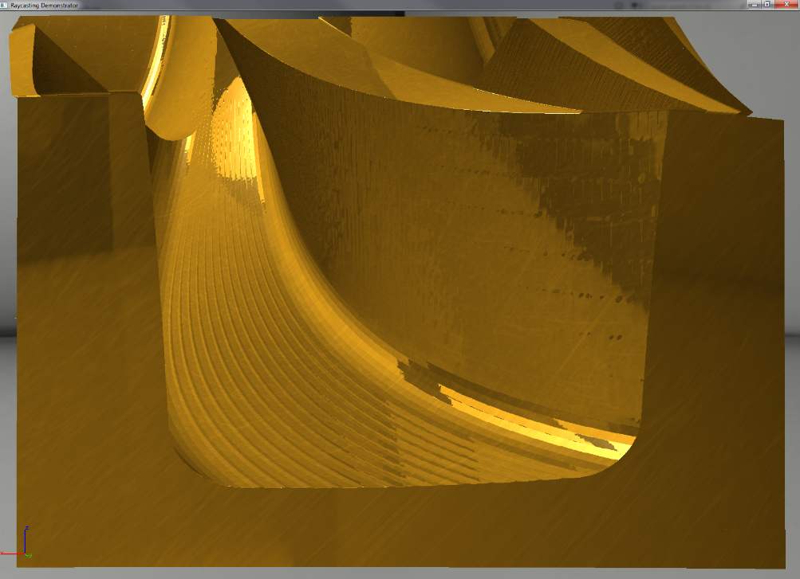
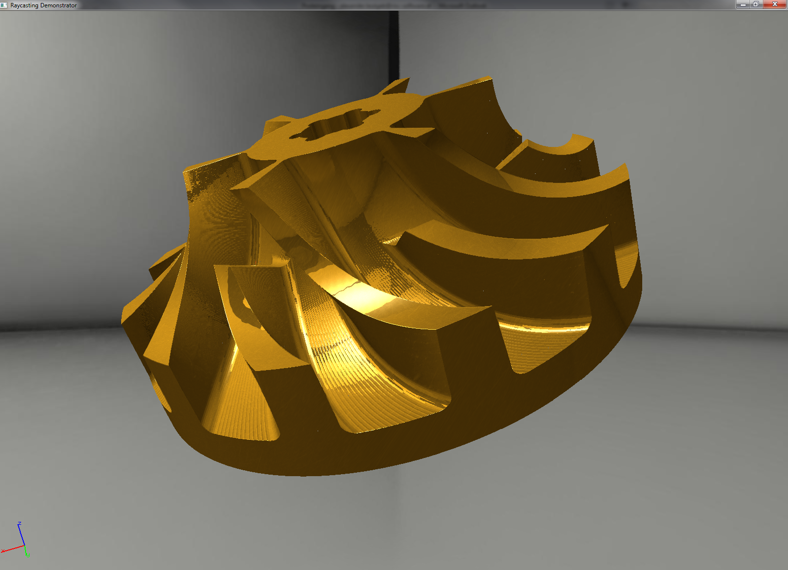
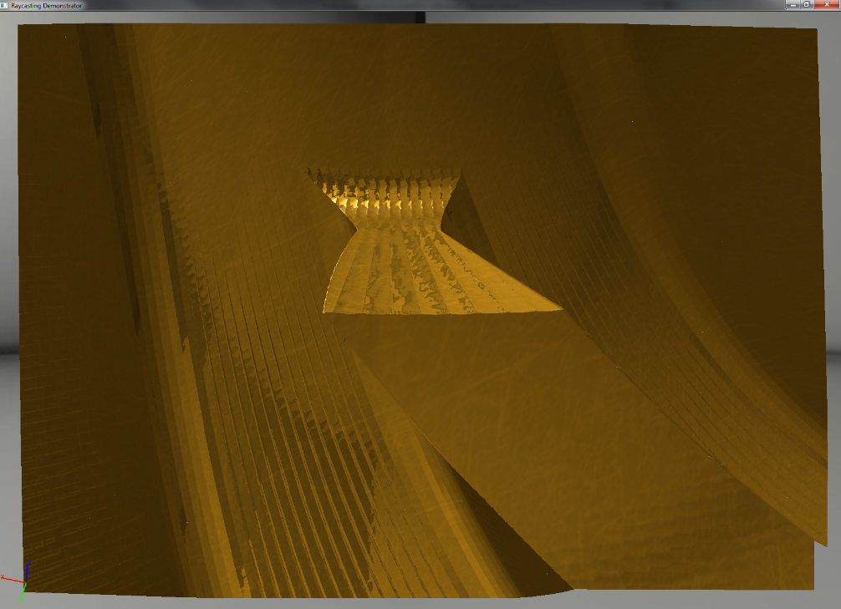
Visual quality

Slide 31
Master thesis
"Detailed and adaptive surface reconstruction of implicitly defined geometries"
Regular grid with swept volumes as input
Will (hopefully) calculate exact surface as triangle mesh
See you in December ;)

